Slide 1

“CHECK YOUR RATE OF INFECTION IN COVID-19 VIRUS” Software Development I (CSE 100)
BUBT
Logo
Submitted By:
Mahira Arefin (19202103337)
Farhana Islam (19202103333)
Md.Rashidul Haq (19202103356)
Submitted To:
Umme Hafcha Mukti
Course Instructor, Dept. of CSE,
BUBT

Slide 2
INTRODUCTION:
My project shows your about your health. This project helps to check your rate of infection in Covid-19 Virus and also can store all the information.

Slide 3
MOTIVATION:
This program is very useful for us cause people can known about their rate of infection in Covid-19 Virus.
People can store their information , add, edit, search, delete their information .
This program is very useful for us cause people can known about their rate of infection in Covid-19 Virus.
People can store their information , add, edit, search, delete their information .

Slide 4


Software Requirements :
Windows XP210
CodeBlocks

Slide 5
Algorithms :
No Algorithm used.
File handling is used to save and store information.

Slide 6
Demonstration :
struct ad
{ //All the functions which we need
char name[30];
char state[30];
char chance[30];
char phone[30];
char age[30]; }
x[100];
void read();
void add();
void view();
void search();
void edit();
void del();
void show();
void fun1();

Slide 7
Demonstration :
void add() //For Add information
{
printf("\n\n");
printf("Already data inputed on the database = %d\n\n",num);//how many inputs
printf(" How many entry do you want to add= ");
scanf("%d",&n);
sum=n+num;
}

Slide 8
Demonstration :
void view() //For view information
{
for(i=0; i<num; i++)
{
printf(" Serial Number=%d\n",i);
printf(" Name = ");
puts(x[i].name);
printf(" state = ");
puts(x[i].state);
printf(" Chance of corona = ");
puts(x[i].chance);
printf(" Phone number = ");
puts(x[i].phone);
printf(" Age = ");
puts(x[i].age);
}

Slide 9
Demonstration :
void edit() //For editing information
{
int q,p;
fflush(stdin);
printf("\n\n\tWhat do you want to edit ?\n\n\n");
printf("\tEnter your option\n");
printf("\t\t1.Name\n\t\t2.State\n\t\t3.Age\n\t\t4.Chance of corona\n\t\t5.Phone no.\n");
printf("Option=");
}

Slide 10
Demonstration:
void search() //For searching information
{
int s,h,f;
char u[100];
printf("\n\n\tBy what do you want to search ?\n\n");
printf("1.Serial no. 2.Name 3.State 4.Chance of corona. 5.Phone no 6.Age Option = ");
scanf("%d",&h);
}

Slide 11
Demonstration :
void del() //For deleting information
{
int f,h;
printf("\n\tEnter the serial number of the patient that you want to delete=");
scanf("%d",&f);
}

Slide 12
Demonstration :
void write() //For File handling
{
FILE *fp = fopen("patient.txt","w");
if(fp == NULL)
{
printf("Error");
exit(1);
}
fwrite(x, sizeof(struct ad),num, fp);
fclose(fp);
}

Slide 13
Demonstration :
int main()
{
printf(“ INFECTION RATE TEST COVID-19 ”);
if (countt<=20)
printf(" CONGRATS! YOU ARE IN GREEN ZONE ");
else if (countt>20 && countt<=40)
printf(" HEY! YOU ARE IN ORANGE ZONE ");
else if(countt>40)
printf(“ ALERT! YOU ARE IN RED ZONE ");
}

Slide 14
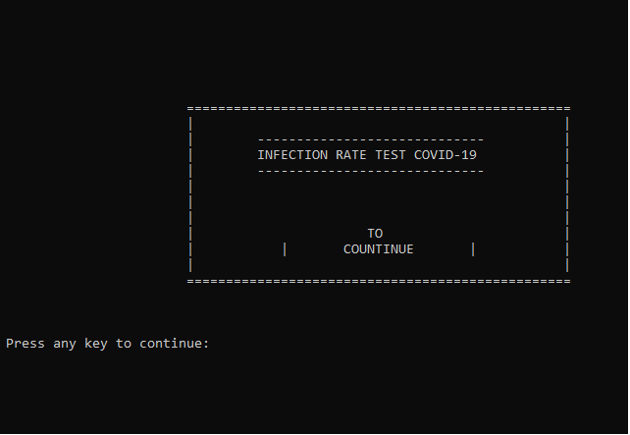
Input:

Slide 15
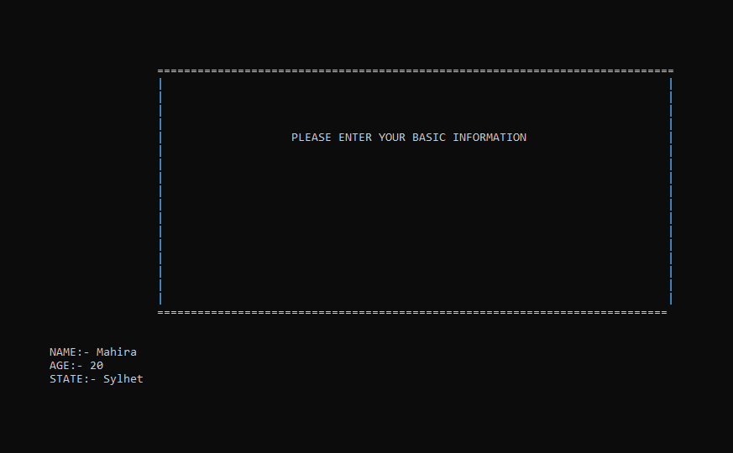
Input:

Slide 16
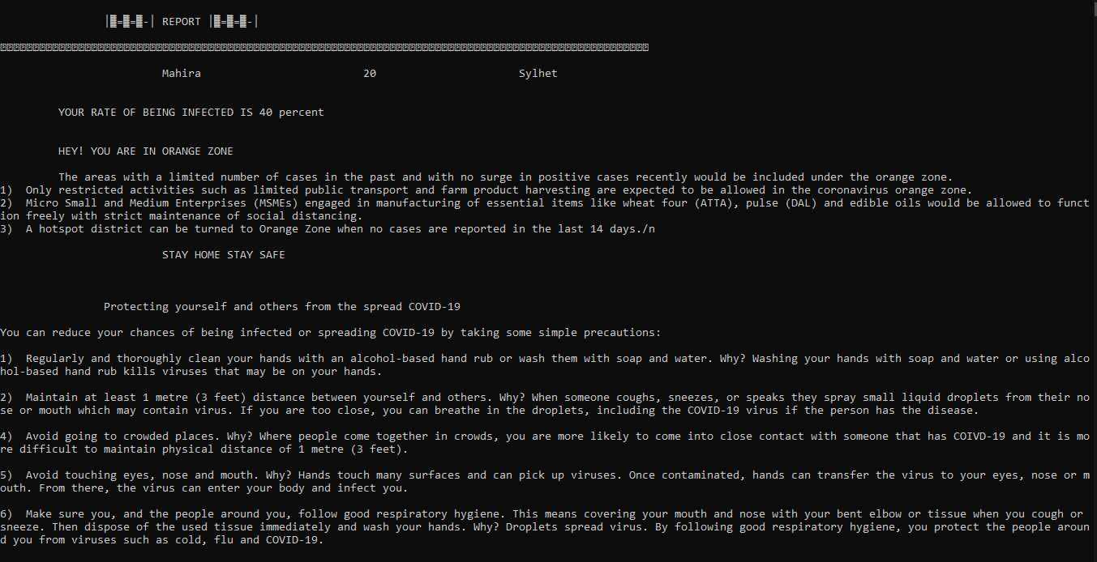
Output:

Slide 17
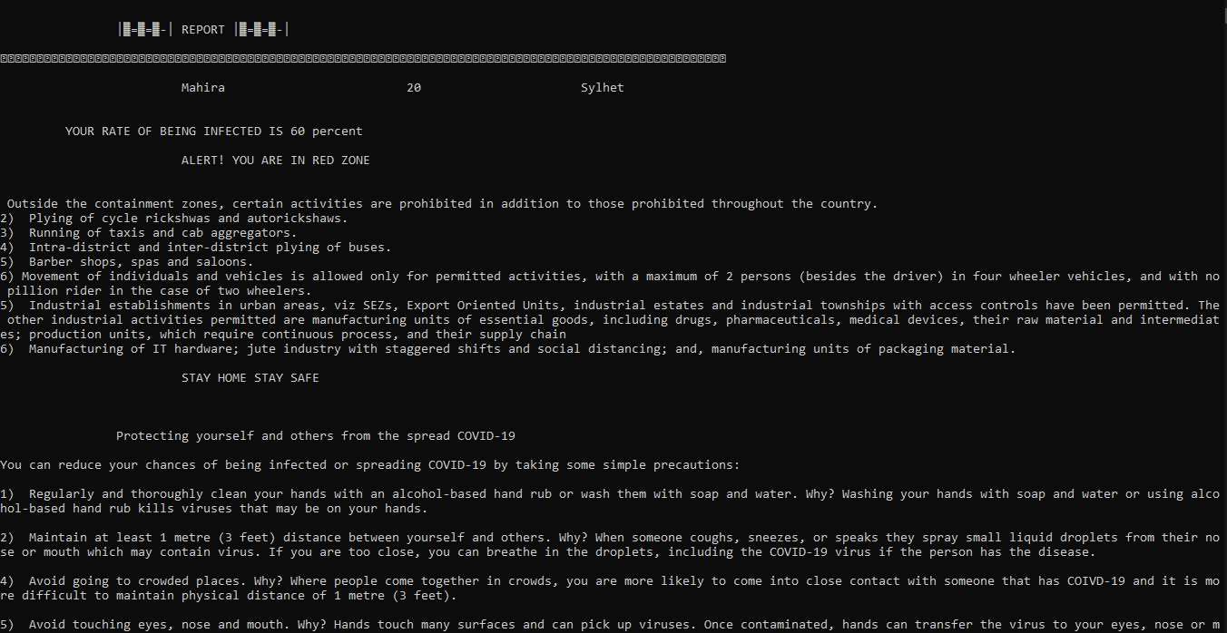
Output:

Slide 18
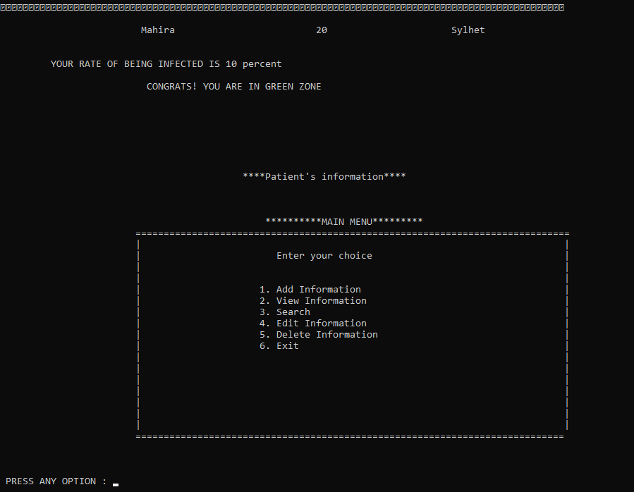
Output:

Slide 19
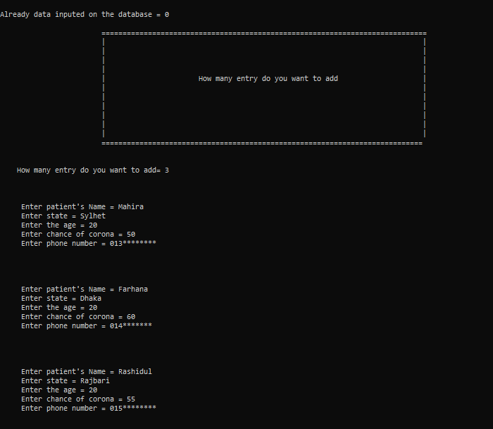

Slide 20
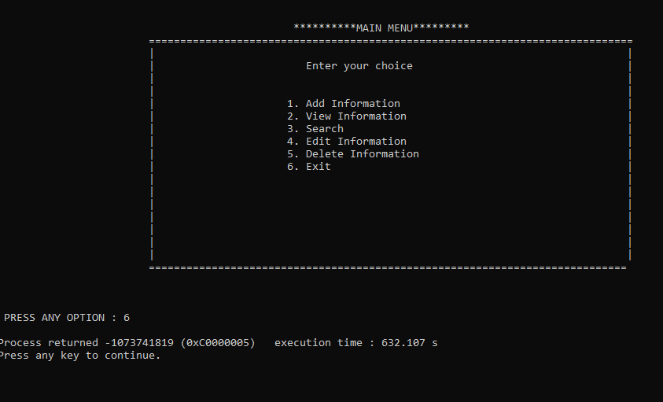

Slide 21
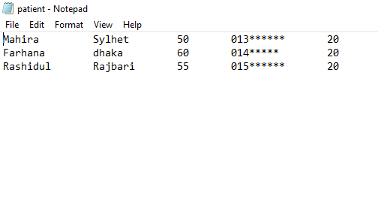
File handling :

Slide 22
Future :
It’s improvement possible.

Slide 23
References :
Programming hub.
Stack overflow.
Google.

Slide 24
Conclusion :
We can check our body condition from home and can understand what to do now and also can take care of themselves according to condition and also can store all the information.

Slide 25

ANY QUESTIONS?......

Slide 26

THANK YOU

